Slide 1
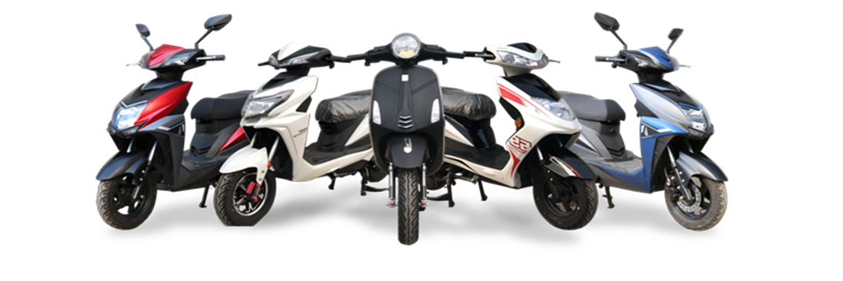

MOVIK INTERNATIONAL
GO GREEN WITH MOVIK

Slide 2
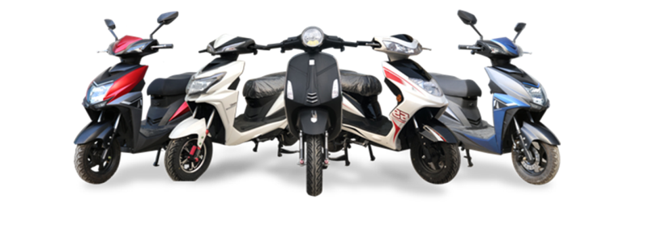
Mission
To create the most suitable and trustable eco-system of electric vehicles and allied components driving the world’s transition to sustainable energy. To achieve this mission, the company will focus on research and development of new technologies, partnerships with other companies in the industry, and customer education and outreach programs.

Slide 3
Vision
To achieve faster and trustable adoption of Electric Vehicles and accelerate world’s transition to sustainable energy. The mission emphasizes the need for speed and reliability in promoting EV adoption and highlights the importance of sustainability as a key factor in this transition. To achieve this mission, the company focus on developing innovative EV products, increasing access to charging infrastructure, and educating consumers on the benefits of EVs. Additionally, the company will work with governments and other organizations to promote EV policies and initiatives that support the widespread adoption of electric vehicles.

Slide 4
About US
Mr Mohit Juneja (Managing Director): B. Com Graduate with over 30 years of experience in field of Cable TV Manufacturing , Electronics and 14 years of experience in Electric Vehicle Industry
Mr Vikas Sharma (CEO): B. Com Graduate with post graduate in Advertising, PR and Journalism having over 28 years of experience in field of Cable TV , Broadcasting , Broadband and Media Industry with very good understanding of market research and customer behavior

Slide 5

Quality service and Trust
Providing Best Quality, Service and building the customer Trust is our mantra to the business with which we wish to achieve the following objectives in EV industry:
Eco-Friendly
Commute

Slide 6
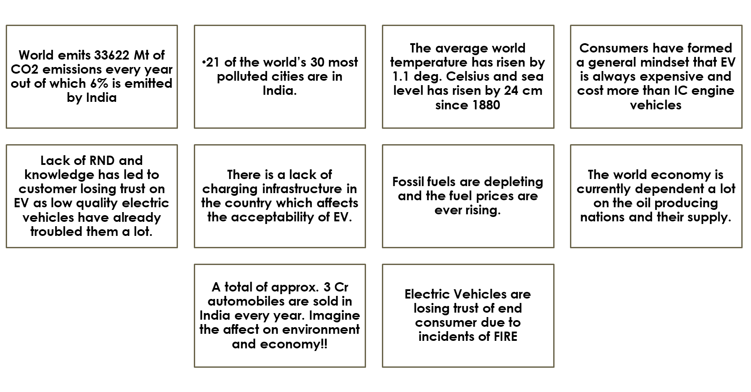
What’s the Problem

Slide 7
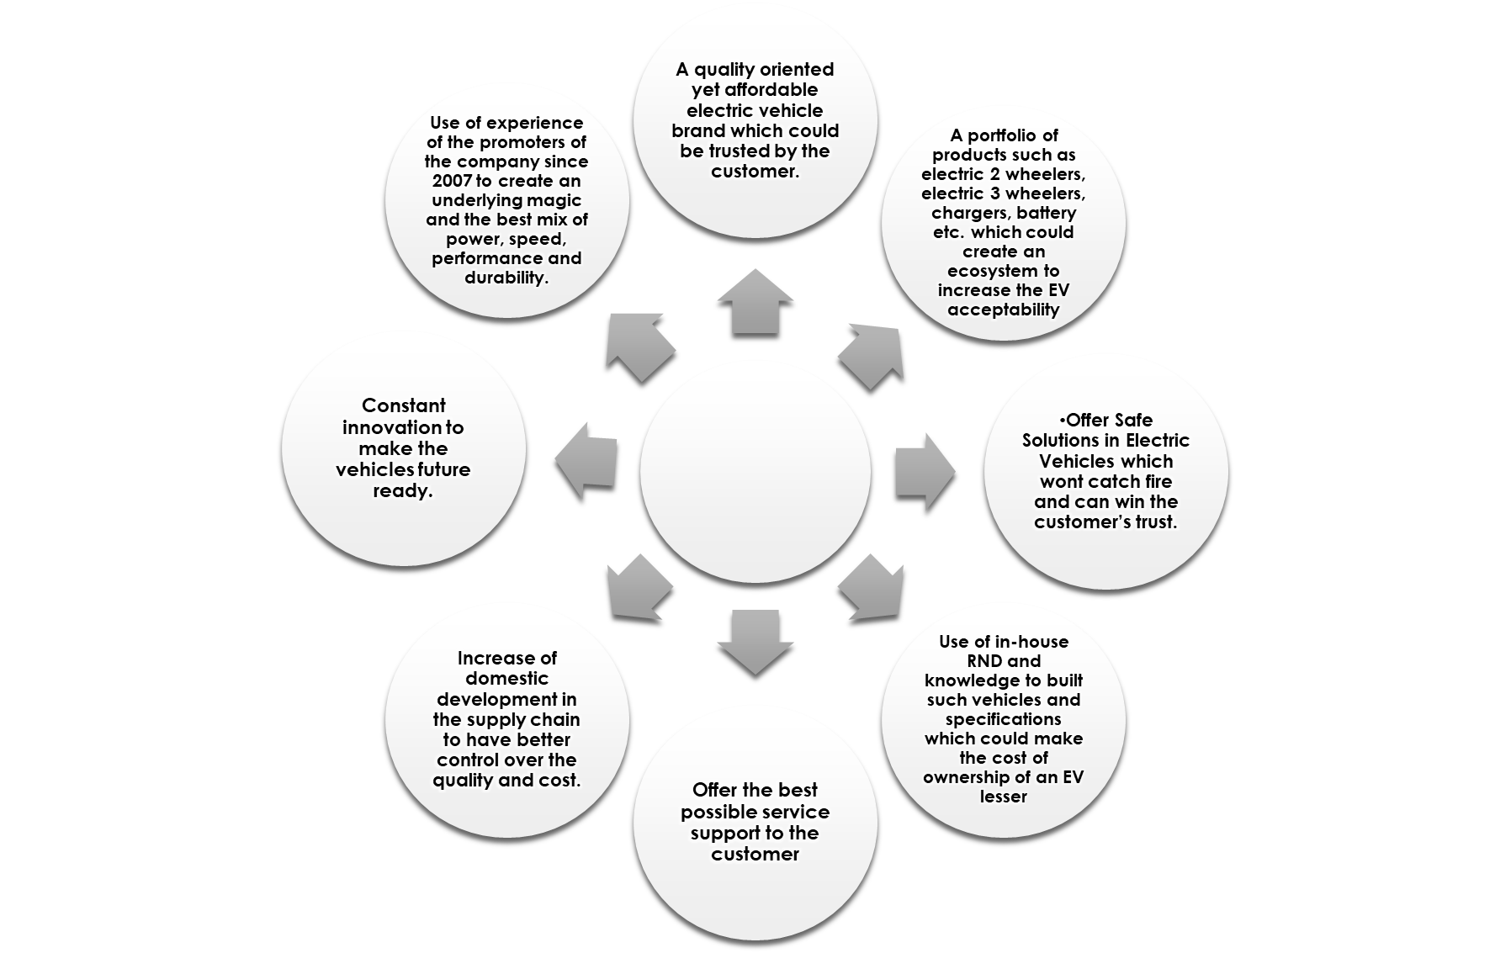
Our Solution
MOVIK

Slide 8
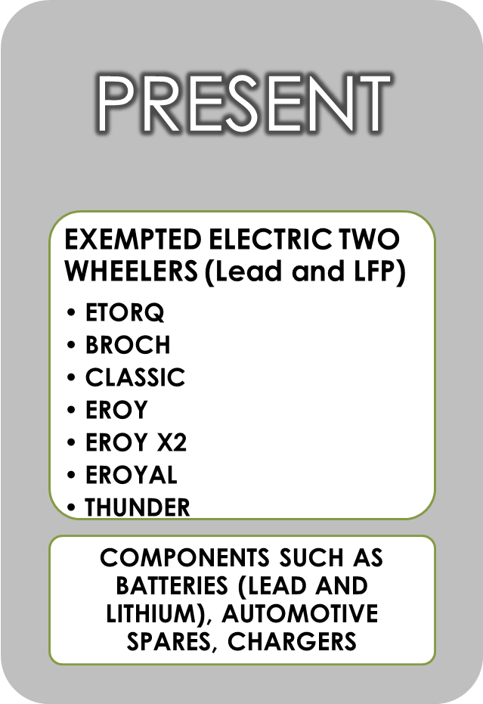
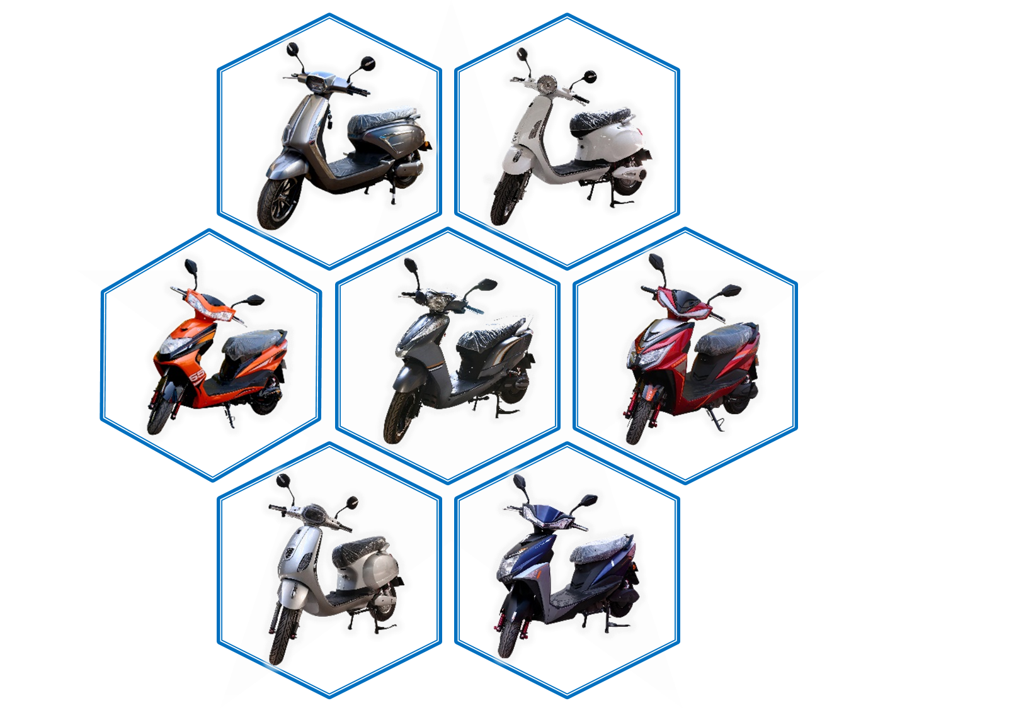
Our Product

Slide 9
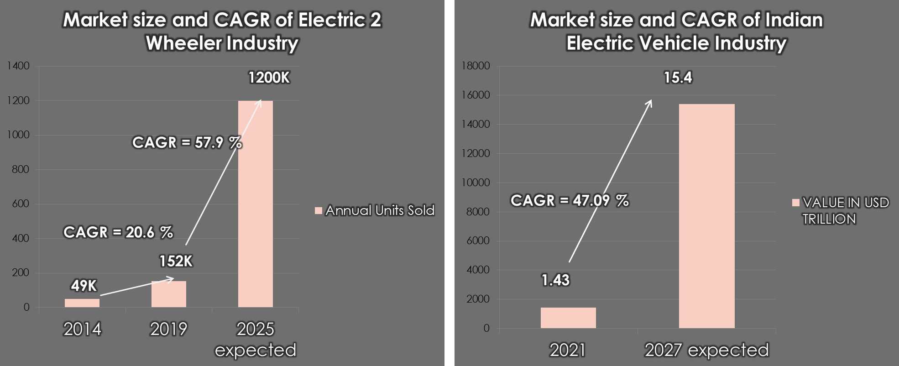
Market Size

Slide 10
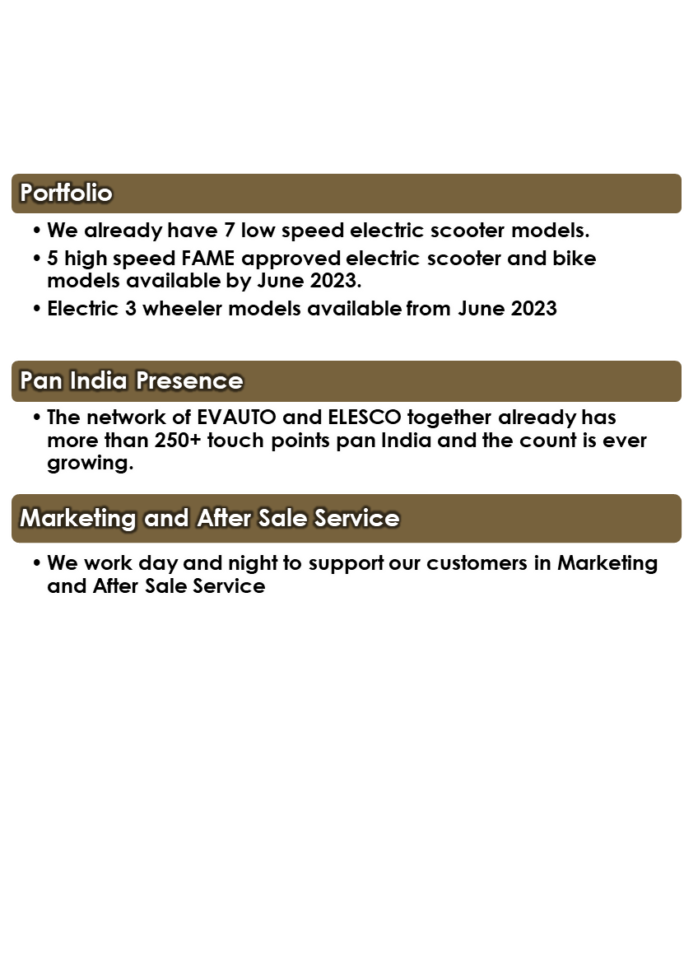
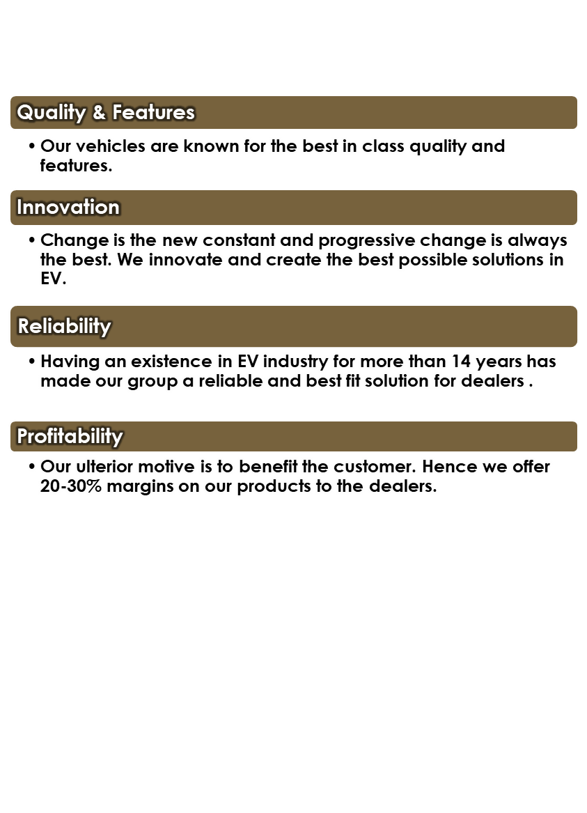
Why Us ?

Slide 11
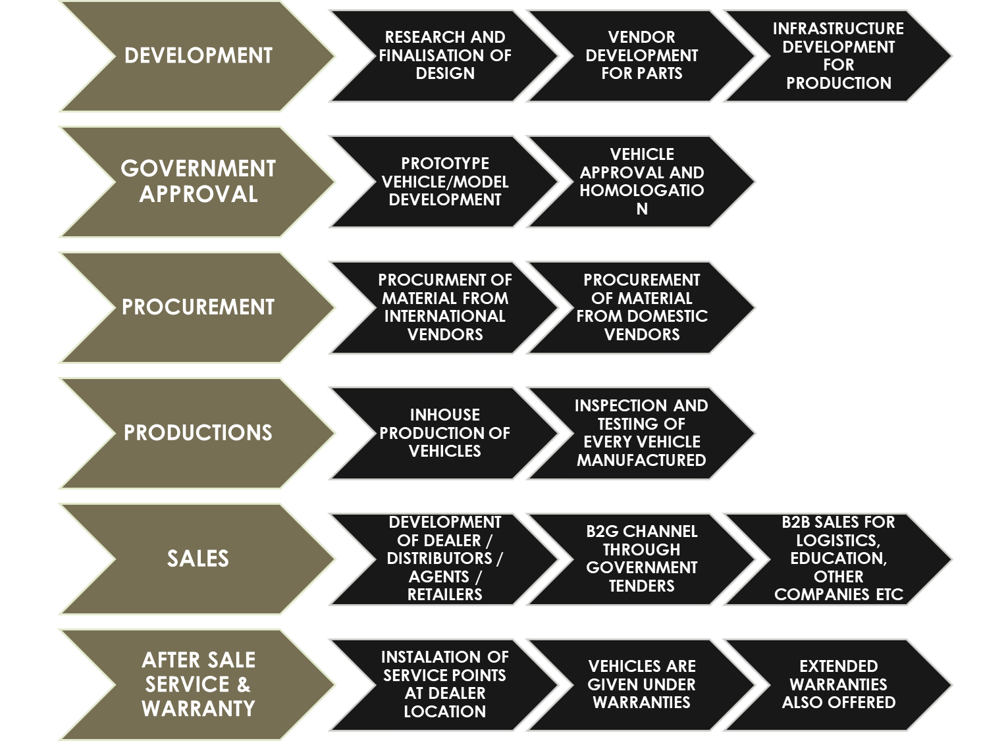


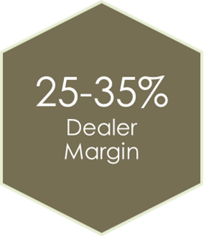
Business Model :

Slide 12
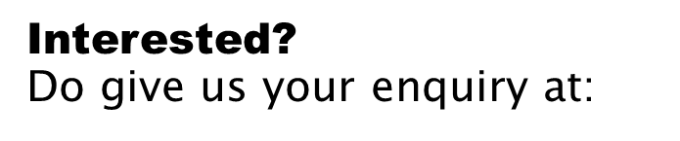
Dealership Enquiry
Call/Whatsapp: +91-9810533544 (Mr. Mohit Juneja- MD) +91-9810120083 (Mr. Vikas Sharma - CEO) +91-9310108486 (Mr. Nikhil Handa- Business Head (INDIA)
Mail:
Website: www.evauto.co.in www.elesco.co.in
For Bank and Finance Tie-Up (Only banks and NBFCs officials)
Call/Whatsapp: +91-9810533544 (Mr. Mohit Juneja- MD) +91-9810120083 (Mr. Vikas Sharma - CEO)
Mail::

Slide 13

MOVIK INTERNATIONAL
Adderss :

